Slide 1
Environmental Station Monitoring System
Made with ThingsBoard and Node.js

Slide 2
Main idea
We want to monitor 2 environmental stations, each with 5 sensors:
- Temperature (- 50 … 50 °C)
- Humidity (0 … 100 %)
- Wind Direction (0 … 360 Degrees)
- Wind Intensity (0 … 100 m/s)
- Rain Height (0 … 50 mm/h)
Each environmental station has a unique ID
We send the data through a MQTT channel to ThingsBoard in the cloud
We visualize the data making it visible to anyone who’d like to.

Slide 3

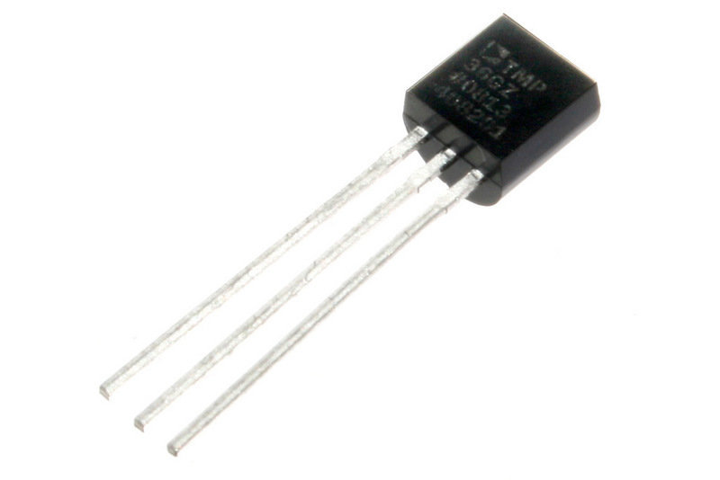

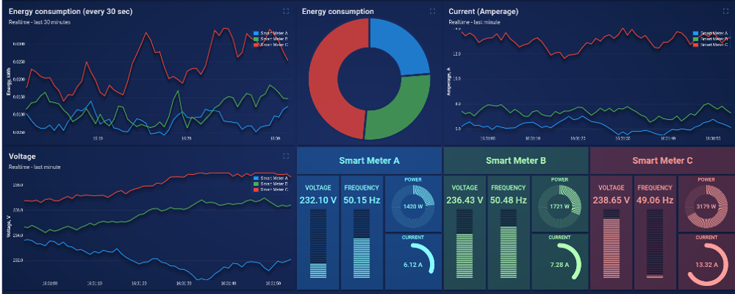

Architecture
Environmental Station 1
ThingsBoard IoT Platform
MQTT Channel
ThingsBoard Dashboard
Environmental Station 2

Slide 4
Implementation
The sensors and environmental stations are simulated by a simple program done with Node.js
ThingsBoard IoT platform collects data through the MQTT channel (MQTT broker integrated in the platform) and shows it on its dashboard, which is public so that anyone could check it out.

Slide 5
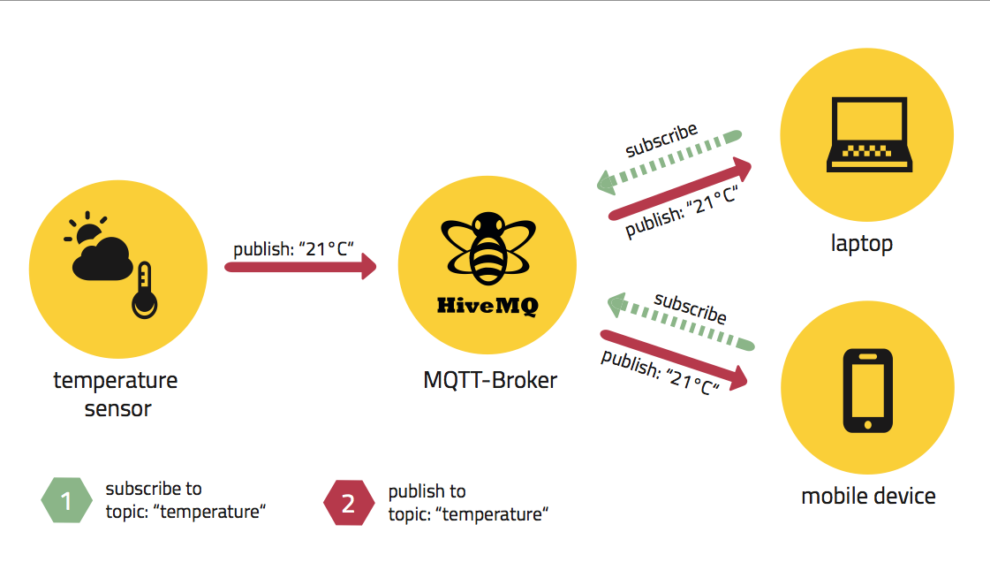
Technology: MQTT Protocol
MQTT is a machine-to-machine connectivity protocol, designed to be lightweight
and work well even in situations where little resources are provided.
Because of this, it’s ideal for sensor communication.
It’s based on the publish subscriber paradigm

Slide 6

Technology: Node.js
Node.js is a JavaScript runtime environment that uses V8 JavaScript Engine (which makes it very smooth and powerful).
It’s run in a single process, without creating a new thread for every connection. In general, it’s thought for an asynchronous and event-driven programming style.
It’s very popular, and has a huge amount of frameworks and libraries.

Slide 7
Technology: ThingsBoard
ThingsBoard is an open-source IoT platform to collect, process, visualize data and manage devices.
Enables connectivity through standard IoT protocols like CoAP, HTTP, MQTT and supports cloud deployment.
The pillars of this platform are scalability, fault-tolerance and performance.

Slide 8
References
Node.js: https://nodejs.org/en
MQTT: https://mqtt.org/
ThingsBoard: https://thingsboard.io

Slide 9
Thank you for you attention!

